Slide 1
THE ISAN FOREST MEDITATION TRADITION: A PRAXIS OF MENTAL WELL-BEING VIS-À-VIS GLOBAL RECOVERY

Slide 2
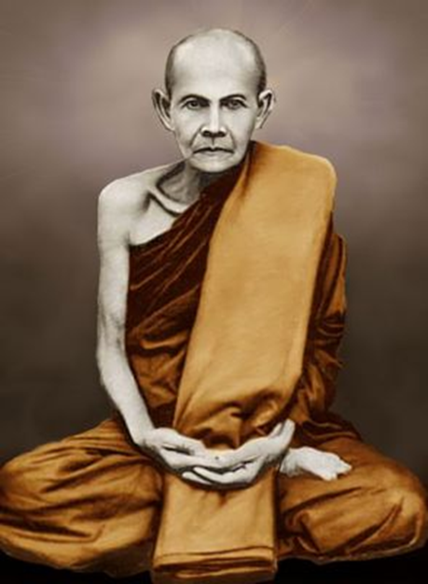
Luangpoo Mun (1870-1949)

Slide 3
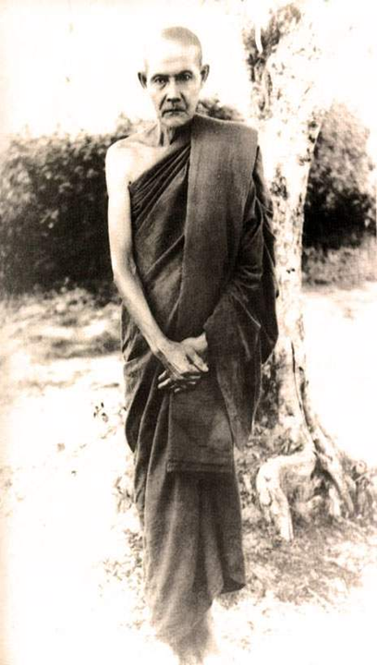

Slide 4
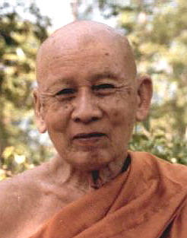
Dhamma in the forest
AJAHN THET (1902-1994)

Slide 5
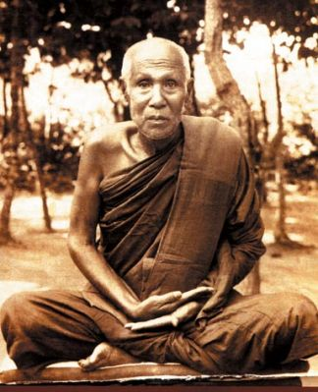
Luangpoo Sao (1859-1941)

Slide 6
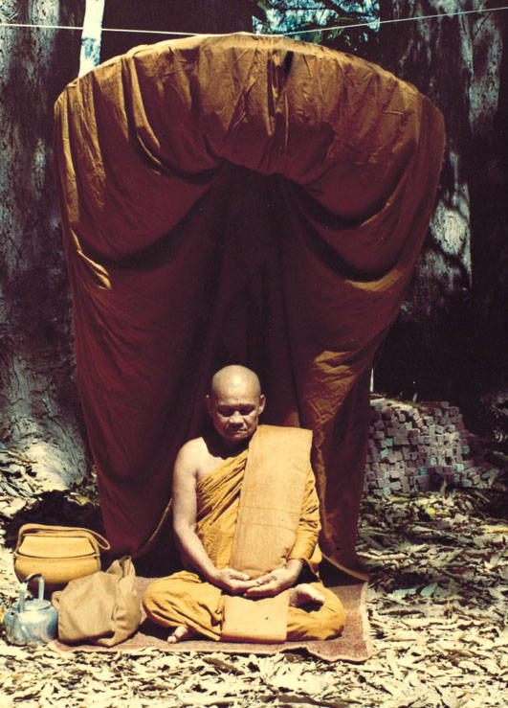
Luangpho Chah (1918-1992)

Slide 7
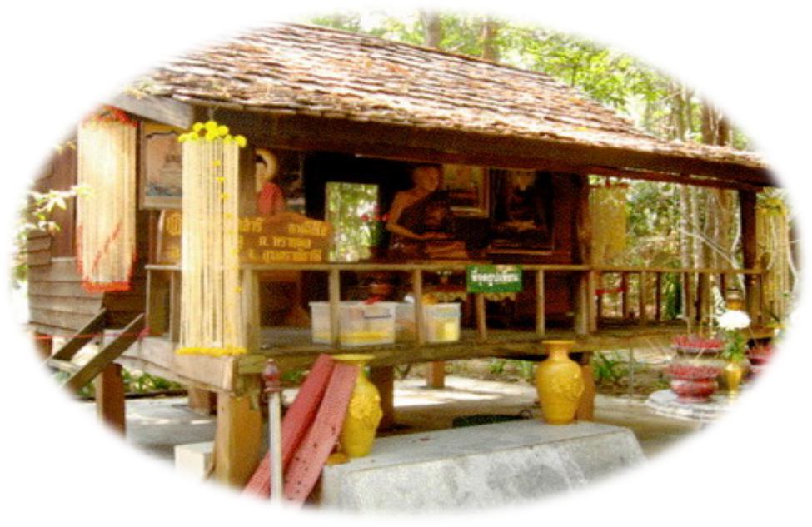
The humble dwelling place

Slide 8
THE CHEDI OF AJAHN CHAH AT WAT NONG PA PONG

Slide 9
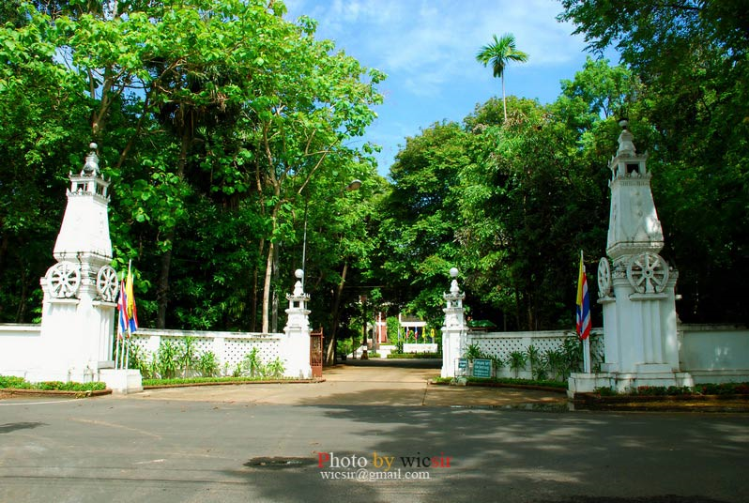
THE ENTRANCE TO THE TEMPLE

Slide 10
INSIDE THE MONASTERY

Slide 11
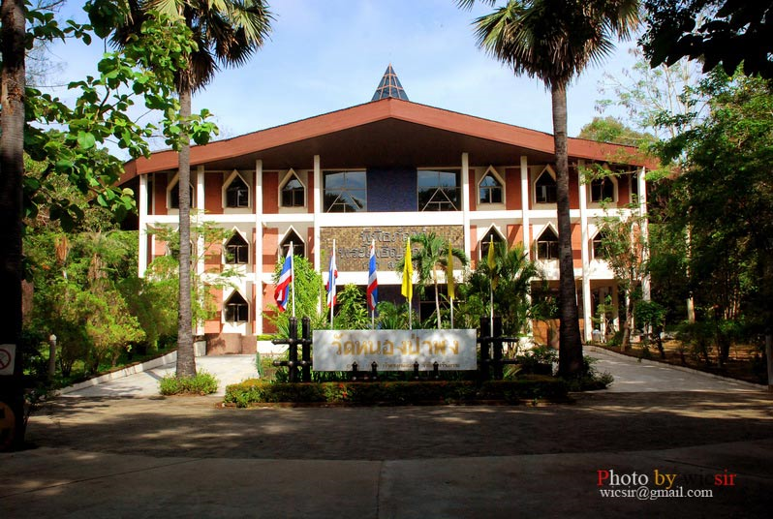
THE MUSEUM AT WAT NONG PA PONG

Slide 12
At the ethico-spiritual level
• The mind is free from defilements
• Morality is established on a firm footing
• The mind becomes non-confrontational

Slide 13
At the psychological level
The mind is enriched by the flow of positive emotions
The mind is non-reactionary to adverse elements
Non self-destructive and infusion of inspirational joy

Slide 14
At the contemplative level
The mind comes to a state of equanimity
The mind transcends the ego
The mind transcends the state of functioning within oppositional polarities
The mind develops non-attachment or non-clinging
The mind is infused with the sublime states

Slide 15
In the numerous dhamma talks of the renunciant monks of the forest tradition, it is clearly reflected that the trained mind of a meditator transcends its own ego and at a higher contemplative level proceeds to deconstruct all dualistic notions starting from the very concepts of me and mine, I and the other.

Slide 16
As Luangpho Chah succinctly expresses, “Give up clinging to love and hate, just rest with things as they are. Do not try to become anything. Do not make yourself into anything. Do not be a meditator. Do not become enlightened. When you sit, let it be. When you walk, let it be. Grasp at nothing. Resist nothing.”

Slide 17
Deconstruction and binary oppositions
Contemporary western philosophy, especially Derridean deconstruction sees the influence of the traditional binary oppositions such as true–false, original–derivative, unified–diverse as infecting all areas of life and thought, including the evolution of western philosophy from the time of Plato to Heidegger.

Slide 18
Derrida in his text The Gift of Death states that: “I cannot respond to the call, the request, the obligation, or even the love of another, without sacrificing the other other, the other others.”

Slide 19
According to him, this is because: “I am responsible to anyone (that is to say, to any other) only by failing in my responsibility to all the others, to the ethical or political generality. And I can never justify this sacrifice; I must always hold my peace about it…What binds me to this one, remains finally unjustifiable.”

Slide 20
From the Buddhist perspective, Derridean dismantling of dualistic hierarchies is radical at the ‘political’ level, but is a metaphysical cul-de-sac since it cannot detach itself from the act of parasitical engagement with the play and teasing apart of binary oppositions.

Slide 21
In one of his dhamma talks Luangpho Chah says, “You must go beyond all words, all symbols, all plans for your practice. Then you can see for yourself the truth arising right there. If you don’t turn inward, you will never know reality.”

Slide 22
This turning inward has nothing to do with aggrandizement of the individual ego, but rather its objectivization through the realization of its workings within the natural paradigmatic truth of existence – anicca, dukkha and anattā.

Slide 23
The venerable ajahn has reiterated the message of empting the mind in most of his dhamma talks – “When you practice, observe yourself. Then gradually knowledge and vision will arise of themselves. If you sit in meditation and want it to be this way or that, you had better stop right there. Do not bring ideals or expectations to your practice. Take your studies, your opinions, and store them away.”

Slide 24
Buddhism and deconstruction
Buddhism in its core essence is a conscious and rigorous deconstructive practice that places the whole of our being and existence both in the physical/material and mental/spiritual sphere under erasure. This is possible because Buddhism is an atheistic religion and views life as impermanent, suffering, and non-self.

Slide 25
The following entities are not opposing conditions or dualistic hierarchies, but desired progression to higher levels of truth and spiritual understanding.
worldly life ➝ renunciation
faith ➝ rationalization
rationalization ➝ non-attachment
self ➝ non-self

Slide 26
Ideally, worldly life should progress towards selfless renunciation (or monastic life), faith or devotion should deepen with a rational understanding and not directed to orthodoxy or blind adherence and rationalization should progress to non-attachment/non-clinging even to one’s own faith since there is no self (attā) that is absolute or ever-lasting.

Slide 27
Buddhism looks at all things in terms of integrated factors. There is no real self or essence in all things and so the Cartesian dictum cogito ergo sum (I think, therefore I am) that has influenced and directed western thinking down the centuries has a reverse call in Buddhism – I think, therefore I am NOT.

Slide 28
The forest tradition vis-à-vis Derridean deconstruction
The forest tradition monks as followers of the Buddha themselves worked very much within the framework of a form of deconstruction that we may as well name as empirical deconstruction.

Slide 29
These monks who emphasized on the thudanga practice geared their deconstructive endeavours to none other than the dawning of an inner peaceful state upon the transcendence of their ego, conventional truths, mental-formations and attachment to such mental states.

Slide 30
They developed and adhered to a life’s philosophy that was based on a rigorous deconstructive mode of practice that gave rise to a practical discourse of annihilation of the ego and the resultant understanding of state of ‘being’ (both mental and physical) as it-is-in-itself.

Slide 31
This mode of practice can thus be categorized as empirical deconstruction or deconstruction-in-praxis. Such a way of practice does not valorize the ‘written’ text, but renders the practice a moment-to-moment phenomenal and empirical garb without at the same time erecting a ‘mega-narrative’ of the self-at-practice.

Slide 32
This is possible because critically reflective Buddhist deconstruction creates the fertile ground for a form of self-introspective practice/scrutiny that goes hand in hand with moral practice and non-attachment to the self and the practice practiced.

Slide 33
“Regardless of time and place, the whole practice of Dhamma comes to completion at the place where there is nothing. It’s the place of surrender, of emptiness, of laying down the burden. This is the finish. It’s not like the person who says, “Why is the flag fluttering in the wind? I say it’s because of the wind.” Another person says because of the flag.”

Slide 34
“The other retorts that it’s because of the wind. There’s no end to this! All these things are merely conventions, we establish them ourselves. If you know these things with wisdom then you’ll know impermanence, suffering and not-self. This is the outlook which leads to enlightenment.”

Slide 35
Anattā is put into practice through the deconstructive mantra of ‘Let Go’ of the forest tradition
According to Luangpho Chah, real meditat-ion has to do with attitude and awareness in any activity, not just with seeking silence in a forest cottage. “In the end, we must learn to LET GO every desire, even the desire for enlightenment. Only then can we be free”.

Slide 36
Lessons from the forest tradition for global recovery
The message of selfless renunciation of the forest tradition monks is a reminder to us in scaling down excessive infatuation with material possessions and unbridled human greed – trends set in by the neo-capitalist market policies and consumerism.

Slide 37
The message of non-clinging of the forest tradition monks is a panacea for the world steeped in the quagmire of growing discontentment.

Slide 38
The lesson of the forest tradition monks’ deconstruction of the ego is useful to end linguistic bickerings, racial prejudices and religious disputes that have bred uncanny hatred, jealousy, vain pride, suspicion, contempt, subjugation and misuse of power among different groups of people.

Slide 39
Luangpho Chah emphasized, “For harmony with the group, we must give up pride and self-importance and attachment to fleeting pleasure. If you do not give up your likes and dislikes, you are not really making an effort.”

Slide 40
The forest tradition monks’ practice of compassion is an inspiring example. Compassion to all living being leads to non-confrontation and harmony – harmony with oneself and with one’s fellow beings and surrounding.

Slide 41
At the mundane or physical level, our reflective understanding of the forest monks’ internalization of non-substantiality or anattā is indispensable to protect the world from rising terrorist activities and highly sophisticated future warfare that might wipe out the entire human civilization from the surface of the earth.

Slide 42
At the supra mundane level, reflective understanding of anattā in day to day life leads to blissful contemplation and makes life worth-living. As Luangpho Chah says, “Our lives are like the breath, like the growing and falling leaves. When we can really understand about falling leaves, we can sweep the paths every day and have great happiness in our lives on this changing earth”.

Slide 43
The forest tradition monks are role models for us in regards to their unwavering moral standpoint. If such a moral standpoint is not cultivated, it would be rather difficult to train our ‘monkey’ minds (equipped with ever more sophisticated technology) and to reduce crimes, corruptions, exploitations and misuse of power.

Slide 44
The type of mindfulness that the forest tradition monks have attained is required for our fight with ourselves, to distill our hearts from ‘bad faith’ and sterilize our minds from unwholesome desires so that we are not slavishly caught up in the nexus of me and mine, I and the other. Through the cultivation of mindfulness a holistic world view can be developed.

Slide 45
Conclusion
The dhamma of the forest tradition is down-to-earth, but yet difficult to realize and understand when the mind is ceaselessly caught up in the quagmire of defilements and heedlessness to defilements. It requires moment-to-moment self-scrutiny and mindful practice of ‘letting go’.

Slide 46
In this form of empirical-deconstruction which involves conscientious and mindful teasing apart of all binary oppositions and releasing from their bindings, there is no room for aporia or conflictual and conceptual hiatus.

Slide 47
The forest tradition monks, even though not philosophers in the conventional sense of the term, nevertheless, incessantly worked within the matrix of a mode of practice that can be categorized as a practical-form-of-deconstruction.

Slide 48
It can be concluded that the ‘deconstructive’ tool through which the monks from the forest tradition had sought to dispose of all self/ego arising positions helped lead to a state of knowledge or wisdom (paññā) the cutting edge of which provide axiomatic guidelines to solving numerous problems encompassing such diverse states and situations as psychological, environmental, and economic.

Slide 49
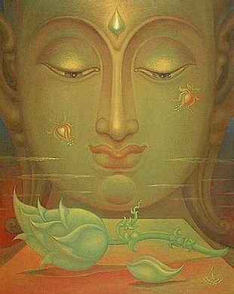
THANK YOU

